Slide 1
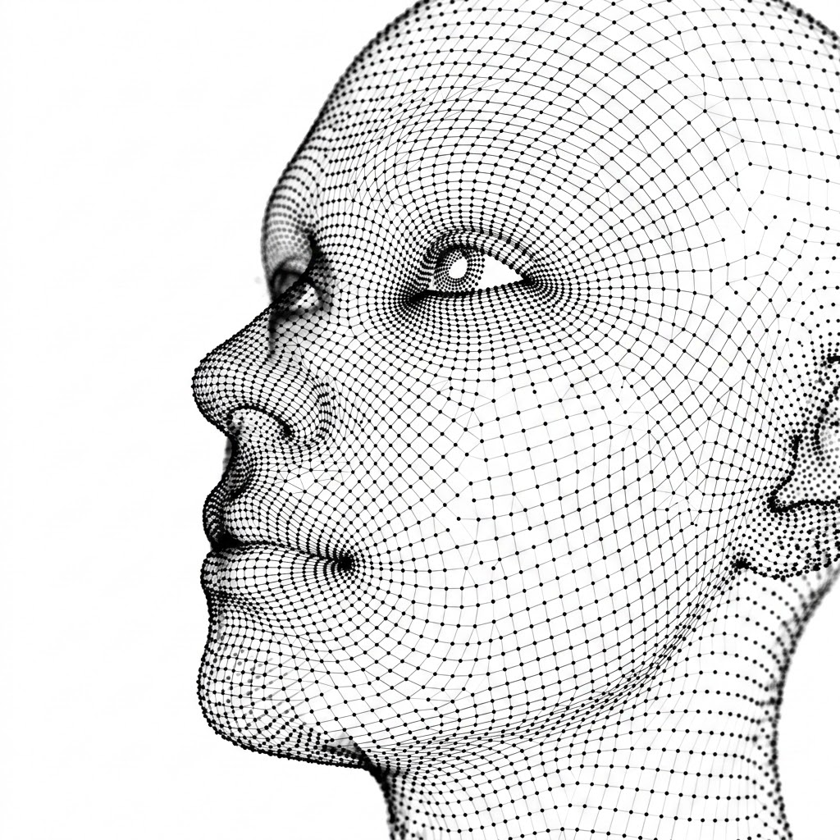
ft. - Face Tokens
Mint Sovereign Face Tokens using Midnight
Team Gravitino
~Khushal Agarwal

Slide 2
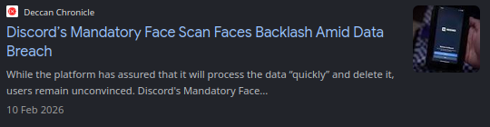
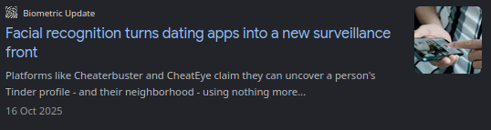
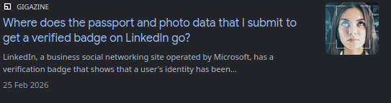
The Problem
Hundreds of apps and Hundreds of
Verifications, all of them want your
biometric, facial, Gov ID data.
But they do not care about data safety
-Third-party verifiers involved and your data is not safe
JUST ONE BREACH AWAY
JUST ONE MALICIOUS INTENT AWAY
and more…

Slide 3
Solution - ft.
Local and secure self attestor ML models
Midnight ZK Proof server locally creates ZK proofs
You get unique facial vector hash which can be reused in multiple websites supporting ft.
Facial/Humanity NFT also minted in users wallet
Same face = always same output, you can wear and look messy and still get the same token if re-verification is needed

Slide 4
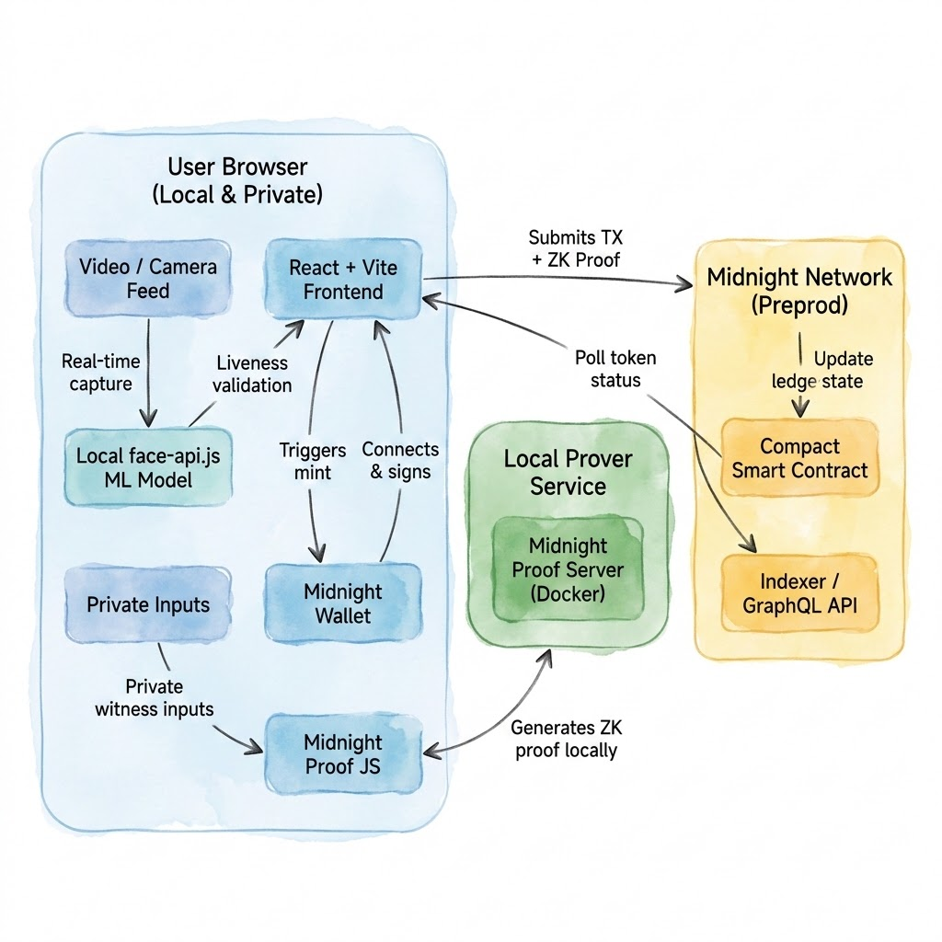
How it works?

Slide 5
What more can be built?
Universal Biometric SDK: An open-source package adding local face and fingerprint ZK verification to any app or protocol.
On-Device ID Matching: Compare a live selfie against a government ID locally to generate a privacy-first ZK match proof.
Custom Verifier Engine: Let external platforms easily build and enforce their own verification rules.
Private Age Verification: Prove "Over 18" status for age-gated sites without revealing exact birthdates or personal details.
Sybil-Resistant Voting: Prevent bot manipulation in DAOs with anonymous "one-human, one-vote" proofs.
Cross-Chain Passports: Allow the same ZK humanity proof to act as an interoperable identity pass across Ethereum, Solana, and other networks.

Slide 6
Thank You

